Slide 1
Surface code
An Introduction and Review on Recent Developments Group 28
蔡弘祥 張顥譽 林軒霆

Slide 2
Introduction to the surface code

Slide 3
Quantum error correction
Quantum phenomena such as entanglement provides new methods for computation that could outperform classical computation
Qubits are more fragile than classical bits and require error correction.
Qubits are also subject to the no-cloning theorem and collapse of wavefunction upon measurement
Error correction for quantum systems is possible, and the most widely pursued method is the surface code

Slide 4
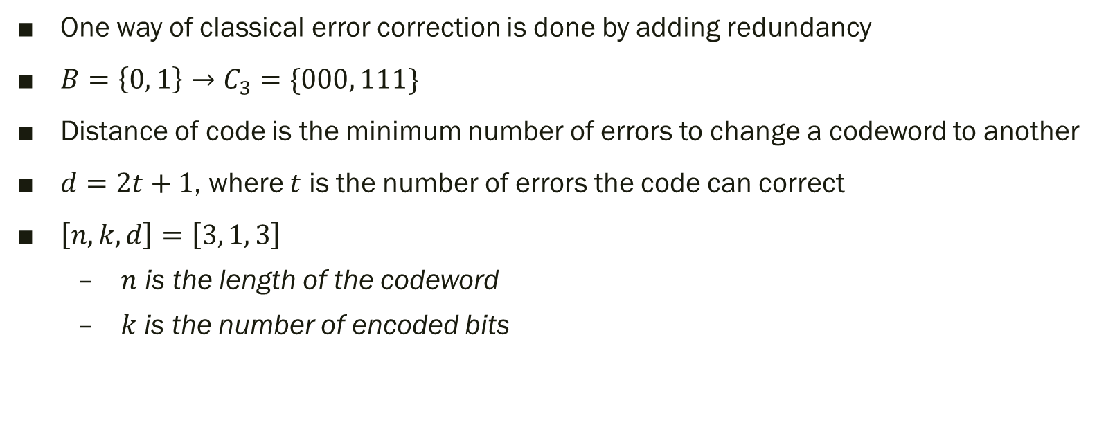
From classical to quantum
One way of classical error correction is done by adding redundancy
$B=\left\{0, 1\right\}→C_{3}=\{000, 111\}$
Distance of code is the minimum number of errors to change a codeword to another
$d=2t+1$, where $t$ is the number of errors the code can correct
$\left[n, k, d\right]=\left[3, 1, 3\right]$
$n$ is the length of the codeword
$k$ is the number of encoded bits

Slide 5
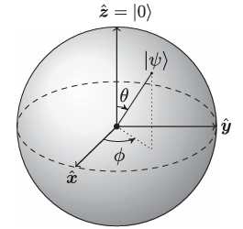
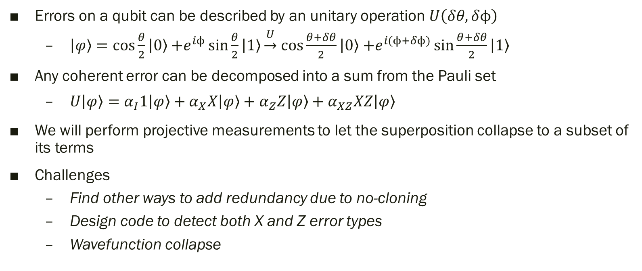
From classical to quantum
Errors on a qubit can be described by an unitary operation $U\left(δθ, δϕ\right)$
$\left.\left|φ\right.\right\rangle =\cos{\frac{θ}{2}}\left|\left.0\right\rangle +\right.e^{iϕ}\sin{\frac{θ}{2}}\left|\left.1\right\rangle \right.\underset{→}{U}$ $\cos{\frac{θ+δθ}{2}}\left|\left.0\right\rangle +\right.e^{i(ϕ+δϕ)}\sin{\frac{θ+δθ}{2}}\left|\left.1\right\rangle \right.$
Any coherent error can be decomposed into a sum from the Pauli set
$U\left.\left|φ\right.\right\rangle =α_{I}1\left.\left|φ\right.\right\rangle +α_{X}X\left.\left|φ\right.\right\rangle +α_{Z}Z\left.\left|φ\right.\right\rangle +α_{XZ}XZ\left.\left|φ\right.\right\rangle$
We will perform projective measurements to let the superposition collapse to a subset of its terms
Challenges
Find other ways to add redundancy due to no-cloning
Design code to detect both X and Z error types
Wavefunction collapse

Slide 6
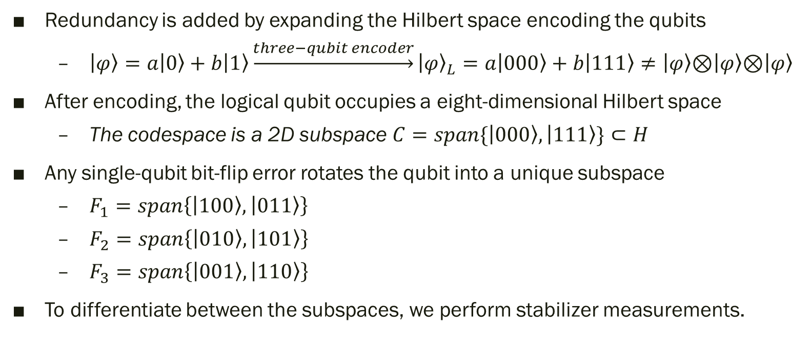
Quantum redundancy
Redundancy is added by expanding the Hilbert space encoding the qubits
$\left.\left|φ\right.\right\rangle =a\left.\left|0\right.\right\rangle +\left.b\left|1\right.\right\rangle \underset{→}{three−qubit encoder}{\left.\left|φ\right.\right\rangle }_{L}=a\left.\left|000\right.\right\rangle +\left.b\left|111\right.\right\rangle ≠\left.\left|φ\right.\right\rangle \text{⊗}\left.\left|φ\right.\right\rangle \text{⊗}\left.\left|φ\right.\right\rangle$
After encoding, the logical qubit occupies a eight-dimensional Hilbert space
The codespace is a 2D subspace $C=span\{\left.\left|000\right.\right\rangle ,\left.\left|111\right.\right\rangle \}⊂H$
Any single-qubit bit-flip error rotates the qubit into a unique subspace
$F_{1}=span\left\{\left.\left|100\right.\right\rangle ,\left.\left|011\right.\right\rangle \right\}$
$F_{2}=span\left\{\left.\left|010\right.\right\rangle ,\left.\left|101\right.\right\rangle \right\}$
$F_{3}=span\left\{\left.\left|001\right.\right\rangle ,\left.\left|110\right.\right\rangle \right\}$
To differentiate between the subspaces, we perform stabilizer measurements.

Slide 7
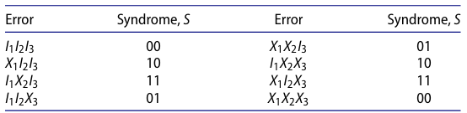
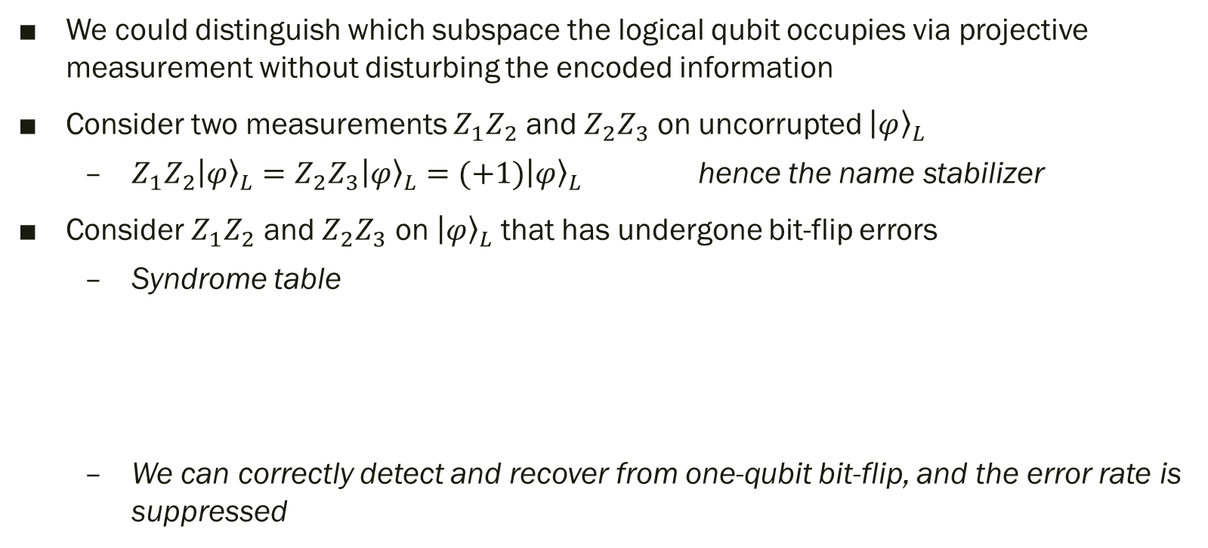
Stabilizer measurements
We could distinguish which subspace the logical qubit occupies via projective measurement without disturbing the encoded information
Consider two measurements $Z_{1}Z_{2}$ and $Z_{2}Z_{3}$ on uncorrupted ${\left.\left|φ\right.\right\rangle }_{L}$
$Z_{1}Z_{2}{\left.\left|φ\right.\right\rangle }_{L}=Z_{2}Z_{3}{\left.\left|φ\right.\right\rangle }_{L}=(+1){\left.\left|φ\right.\right\rangle }_{L}$ hence the name stabilizer
Consider $Z_{1}Z_{2}$ and $Z_{2}Z_{3}$ on ${\left.\left|φ\right.\right\rangle }_{L}$that has undergone bit-flip errors
Syndrome table
We can correctly detect and recover from one-qubit bit-flip, and the error rate is suppressed

Slide 8
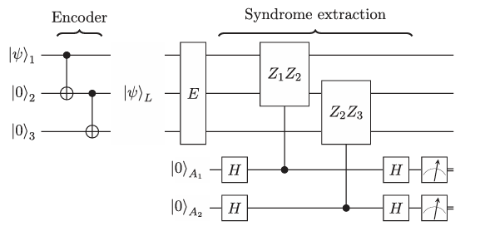
Stabilizer measurements
Circuit diagram of the three-qubit code
We need alternative designs to correct phase-flips

Slide 9
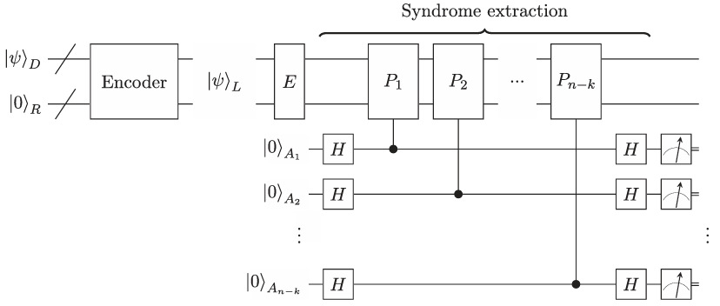

Stabilizer codes
Circuit of a general $[\left[n, k, d\right]]$ stabilizer code
Register of $k$ data qubits is entangled with $n−k$ redundancy qubits
Errors can be detected by performing stabilizer measurements

Slide 10
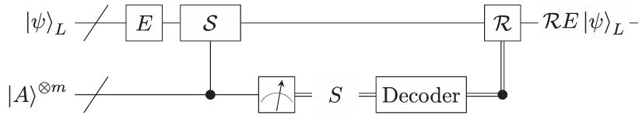
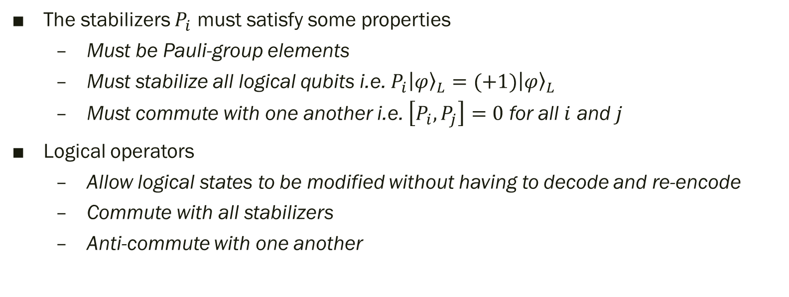
Code stabilizers and logical operators
The stabilizers $P_{i}$ must satisfy some properties
Must be Pauli-group elements
Must stabilize all logical qubits i.e. $P_{i}{\left.\left|φ\right.\right\rangle }_{L}=(+1){\left.\left|φ\right.\right\rangle }_{L}$
Must commute with one another i.e. $\left[P_{i},P_{j}\right]=0$ for all $i$ and $j$
Logical operators
Allow logical states to be modified without having to decode and re-encode
Commute with all stabilizers
Anti-commute with one another

Slide 11
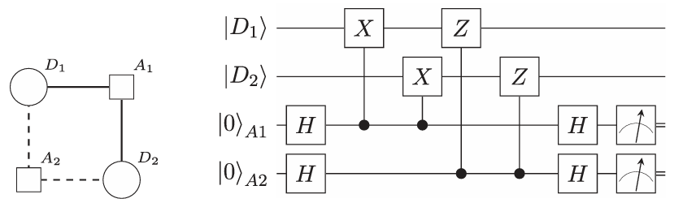
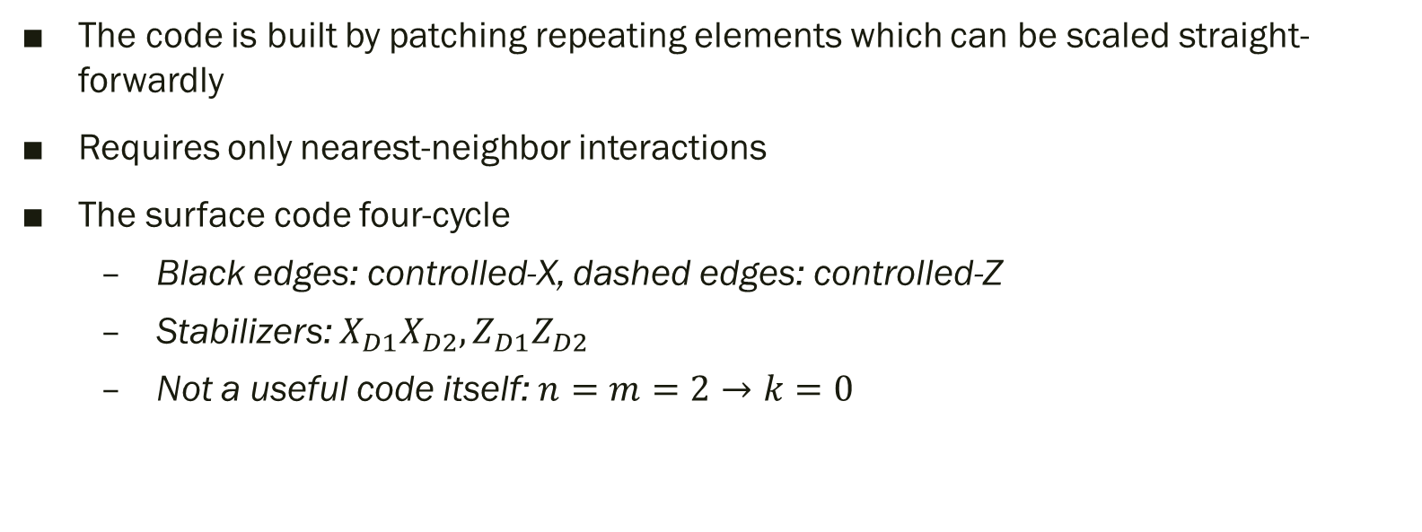
Surface code
The code is built by patching repeating elements which can be scaled straight-forwardly
Requires only nearest-neighbor interactions
The surface code four-cycle
Black edges: controlled-X, dashed edges: controlled-Z
Stabilizers: $X_{D1}X_{D2},Z_{D1}Z_{D2}$
Not a useful code itself: $n=m=2→k=0$

Slide 12
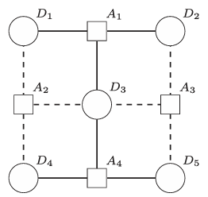
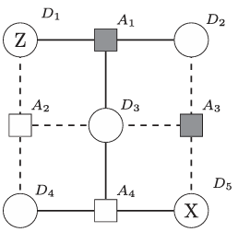
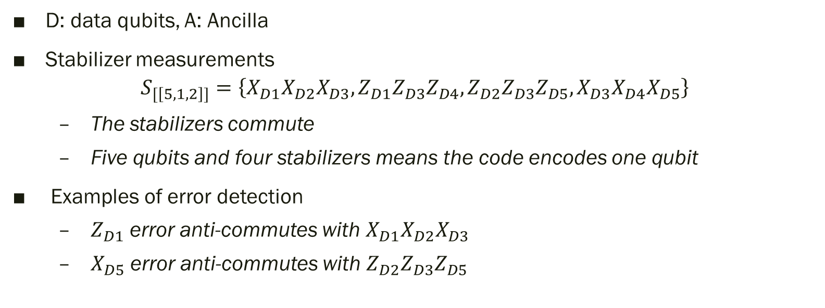
The [[5, 1, 2]] surface code
D: data qubits, A: Ancilla
Stabilizer measurements
$$S_{[\left[5,1,2\right]]}=\left\{X_{D1}X_{D2}X_{D3},Z_{D1}Z_{D3}Z_{D4},Z_{D2}Z_{D3}Z_{D5},X_{D3}X_{D4}X_{D5}\right\}$$
The stabilizers commute
Five qubits and four stabilizers means the code encodes one qubit
Examples of error detection
$Z_{D1}$ error anti-commutes with $X_{D1}X_{D2}X_{D3}$
$X_{D5}$ error anti-commutes with $Z_{D2}Z_{D3}Z_{D5}$

Slide 13
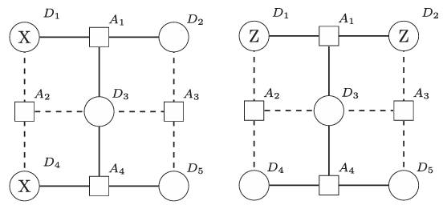

The [[5, 1, 2]] surface code
Logical operators can be defined as chains of Pauli operators
$d=2$
$\overline{X}=X_{D1}X_{D4},\overline{Z}=Z_{D1}Z_{D2}$
Smallest surface code capable of detecting and correcting error: $[[13, 1, 3]]$
$d=3→t=1$

Slide 14
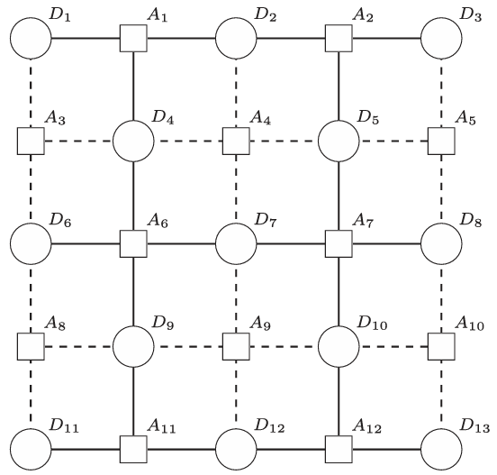
The [[13, 1, 3]] surface code

Slide 15
Practical considerations
Implementation
Laboratories at institutions like Google, IBM Research, and TU Delft are actively working on building superconducting devices
It is estimated that the first fault-tolerant surface code logical qubits will need a lattice of over a thousand qubits
Threshold theorem
The physical error rate of individual code qubits has to be below a certain threshold for surface codes to work
Fault tolerance
Errors may occur at any part of the circuit, and we need to account for them

Slide 16
Practical considerations
Efficient decoding algorithm
Find best recovery to restore quantum information from code syndrome
Constructing a lookup table is impractical for large code sizes
Example: Minimum Weight Perfect Matching (MWPM)
MWPM is a common decoding algorithm, aims to find the most likely string patterns with the same syndrome nodes
Errors in the surface code create patterns of syndromes that can be effectively decoded by pairing them
Find set of edges such that each node is connected to exactly one other node, and the total weight of the matching is minimized

Slide 17
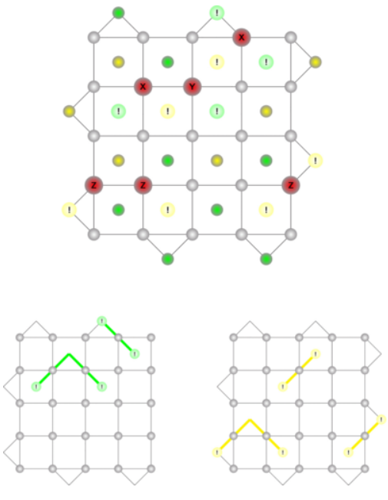
Example of decoding algorithms: MWPM
Red circles: nontrivial Pauli operators
Yellow / Green circles with !: Ancillas where stabilizer measurement outcome changes
Green / Yellow lines: resulting X-check and Z-check after MWPM

Slide 18
Paper review
and recent developments of the surface code

Slide 19
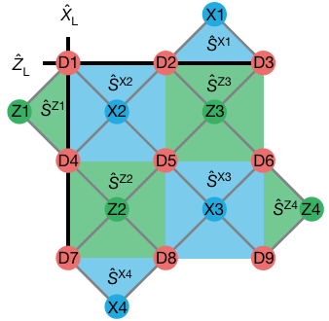
Implementation of a distance-three surface code (1/3)
“Realizing repeated quantum error correction in a distance-three surface code”
Researchers in 2021 have successfully implemented a distance three surface code
https://arxiv.org/abs/2112.03708
The code involves 17 qubits, consisting of 9 data qubits and 8 ancillary qubits.
Each error correction cycle takes 1.1 μs.
Low error probability of 3% per cycle

Slide 20
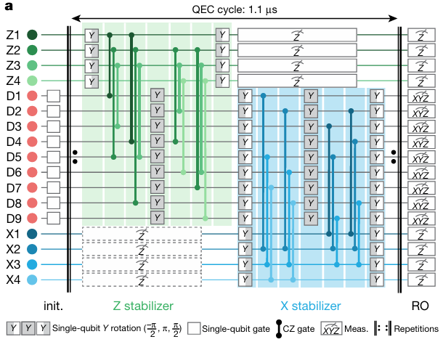
Implementation of a distance-three surface code (2/3)

Slide 21
Implementation of a distance-three surface code (3/3)
decode both bit-flip and phase-flip error syndromes using a minimum-weight perfect-matching algorithm
The mean parity assignment error was found to be 3.9% for weight-two stabilizers and 8.2% for weight-four stabilizers.
Simulations suggest that with improvements in gate and readout fidelities, the logical error per cycle could be reduced significantly

Slide 22
Scaling the surface code (1/2)
“Suppressing quantum errors by scaling a surface code logical qubit”
Published in Nature on February 23, 2023, by Google Quantum AI
https://doi.org/10.1038/s41586-022-05434-1
The distance-5 code showed a modest improvement over distance-3 codes in terms of logical error probability and logical error per cycle
Improvement in logical error per cycle ((2.914 ± 0.016)% compared to (3.028 ± 0.023)%)

Slide 23
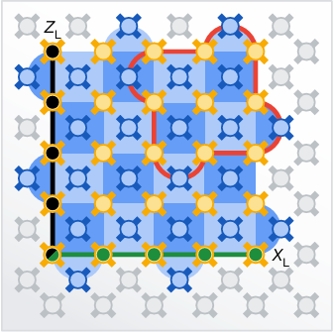
Scaling the surface code (2/2)
Use an expanded Sycamore device with 72 transmon qubits and 121 tunable couplers
Stabilizers are used to detect X and Z errors
Remove certain Hadamard gates to implement the ZXXZ variant of the surface code
growing the lattice does not substantially increase the component error rates
Minimum weight perfect matching algorithm
is used for decoding the syndromes

Slide 24
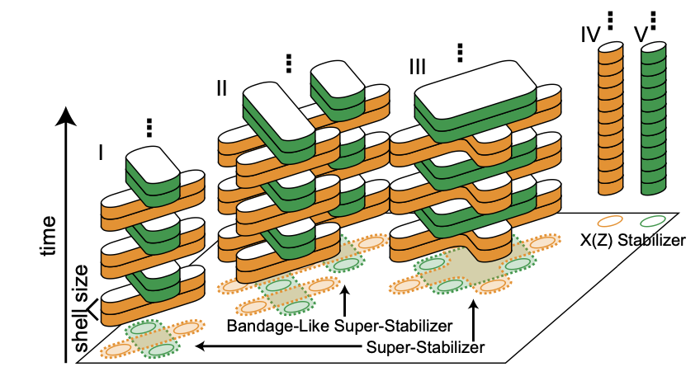
Stabilizers to handle defective lattices (1/2)
“Low-Overhead Defect-Adaptive Surface Code with Bandage-Like Super-Stabilizers”
https://doi.org/10.48550/arXiv.2404.18644
Stabilizers are used to detect errors in the quantum state.
Bandage-like stabilizer helps in managing defects by covering clusters of defective qubits
Besides, it can automate the whole process which is quite important for scalability

Slide 25
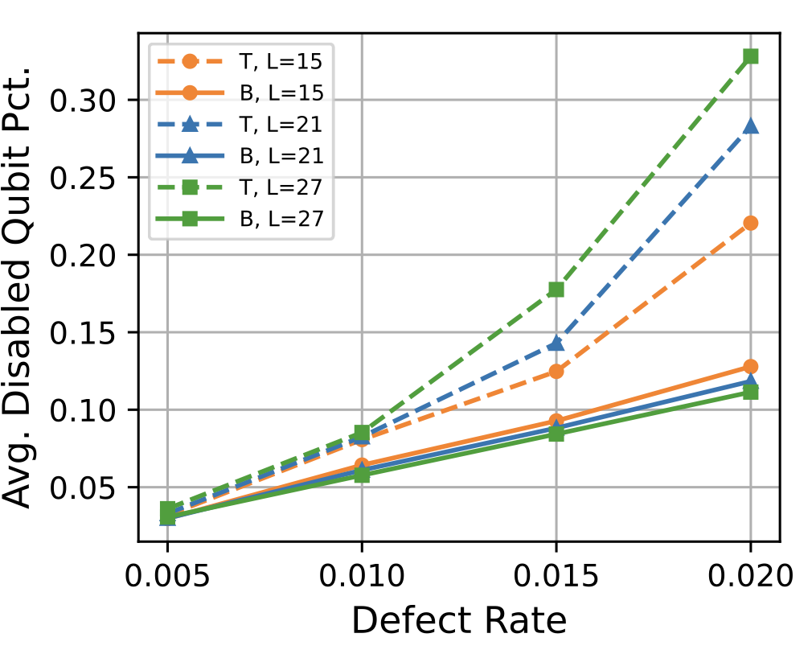
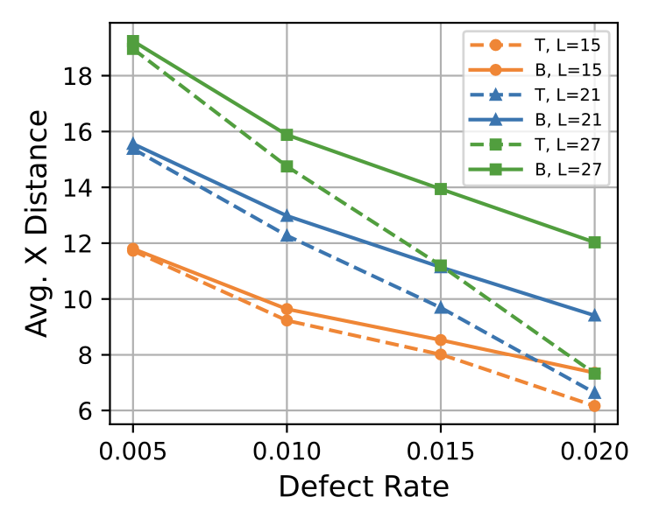
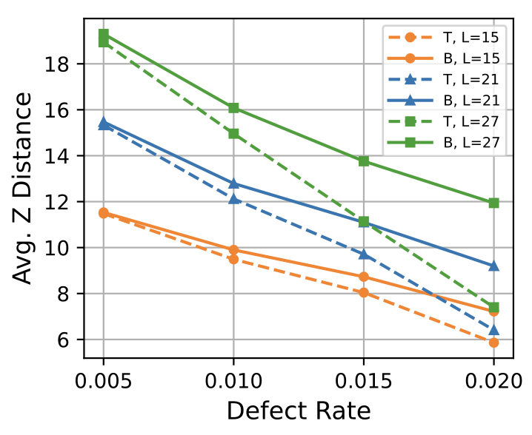
Stabilizers to handle defective lattices (2/2)
Bandage-like method improves performance as the code size and defect rates increase. This method's advantages include a higher average code distance, a lower percentage of disabled qubit

Slide 26
Optimizing decoders (1/4)
“Optimal adaptation of surface-code decoders to local noise”
https://doi.org/10.48550/arXiv.2403.08706
After the code syndrome is acquired, decoder serves to make a guess of the channel error
The trade-off between accuracy and complexity is vital for quantum error correction
Several decoder algorithm are proposed
MWPM
Tensor network
Union find
Maximum likelihood decoding

Slide 27
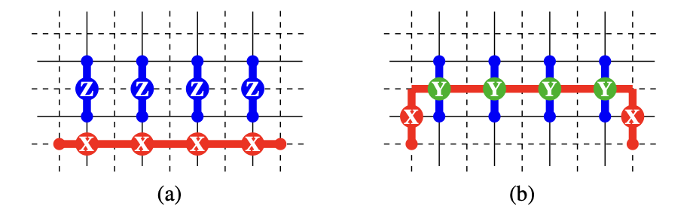
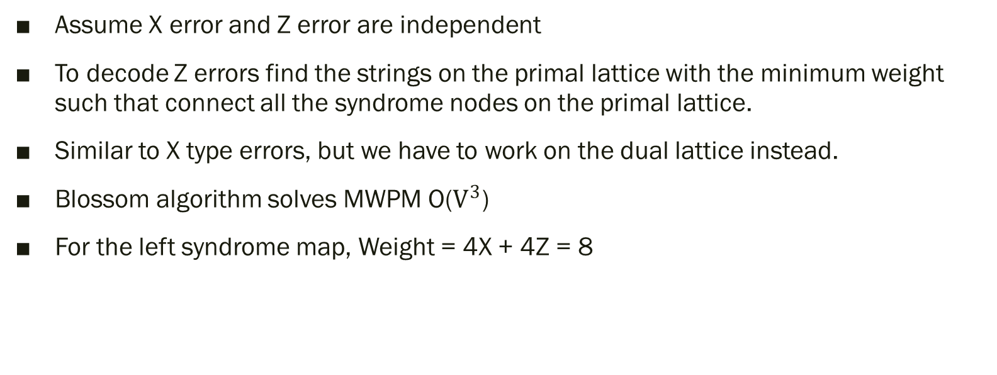
Optimizing decoders (2/4)
Assume X error and Z error are independent
To decode Z errors find the strings on the primal lattice with the minimum weight such that connect all the syndrome nodes on the primal lattice.
Similar to X type errors, but we have to work on the dual lattice instead.
Blossom algorithm solves MWPM O($V^{3}$)
For the left syndrome map, Weight = 4X + 4Z = 8

Slide 28
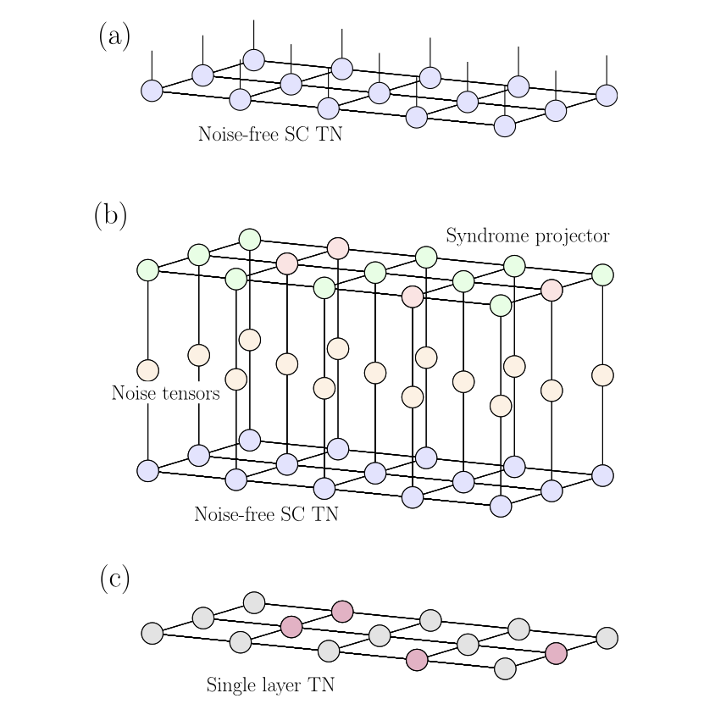
Optimizing decoders (3/4)
Tensor network decoder take all the noise map into account
(a) Each tensor having one physical index.
(b) Three layers corresponding to the noiseless surface
code state, local noise, and a syndrome projector
(c) The same tensor network from (b) expressed as a
single-layer tensor network which is obtained by vertically
contracting the three layers.

Slide 29
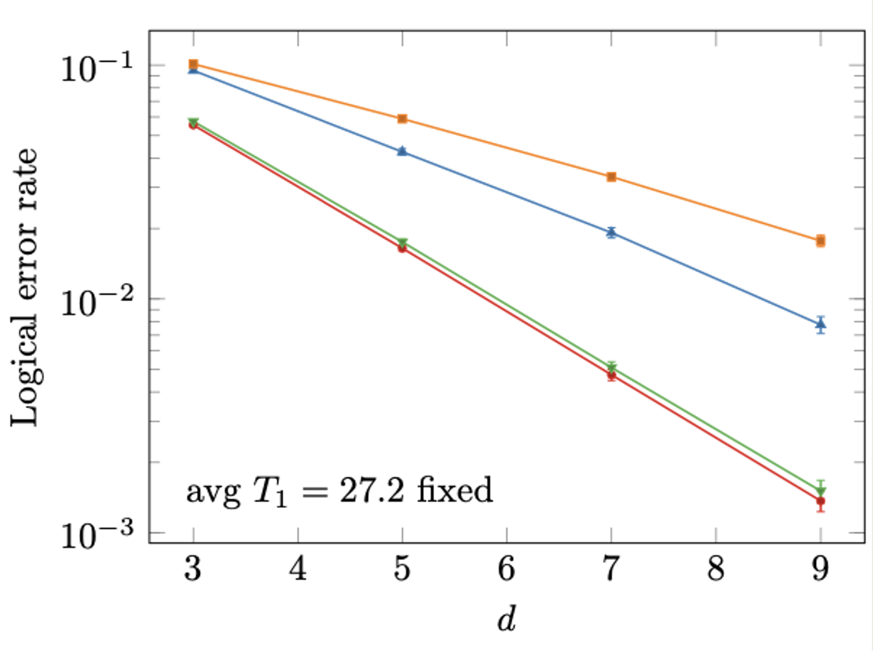
Optimizing decoders (4/4)
Optimizing surface-code decoders by leveraging noise information
Coherence: interactions between different Pauli errors
Inhomogeneity: error varies across different qubits in the device
Bias: prob of different Pauli errors may not be the same
Optimal: decoder with full information of error map
Ratio: only has information about ratio of T1 and T2
Optimal outperforms MWPM
With ratio information, it improves significantly

Slide 30
Realistic quantum noise (1/4)
“Low-distance surface codes under realistic quantum noise”
https://arxiv.org/abs/1404.3747
Why do we need a method that can be efficiently computed
make it possible to handle the complexity of large quantum systems
Use LIQUi|> to simulate under different noise models, apply Pauli-twirl approximation to these noise models, and calculate the pseudothresholds
depolarizing noise
amplitude damping
phase damping
Pauli twirling: convert more complex noise processes into a probabilistic mixture of Pauli errors, making simulations more tractable
Pseudothresholds: the error rate below which the quantum error correction code starts to reduce the logical error rate below the physical error rate
Notes:
What have the authors done

Slide 31
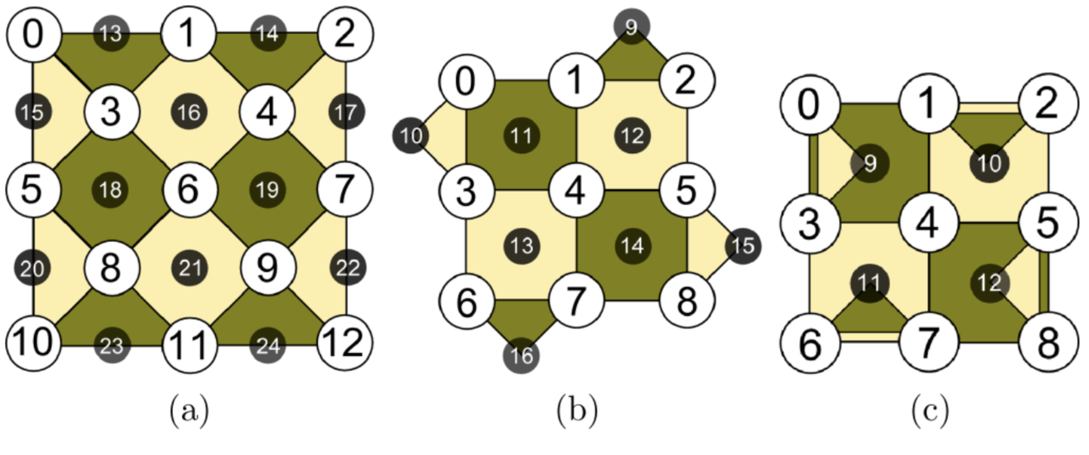
Realistic quantum noise (2/4)
Circuit
25-qubit layout
Standard layout on a (2d-1) * (2d-1) grid, with 13 data qubits and 12 syndrome qubits
17-qubit layout
Reduced from the 25-qubit layout by removing corner data qubits
13-qubit layout
Further reduction by reusing syndrome qubits
White: data qubits
Black: syndrome qubits
Dark square/triangle: X stabilizers
Light square/triangle: Z stabilizers

Slide 32
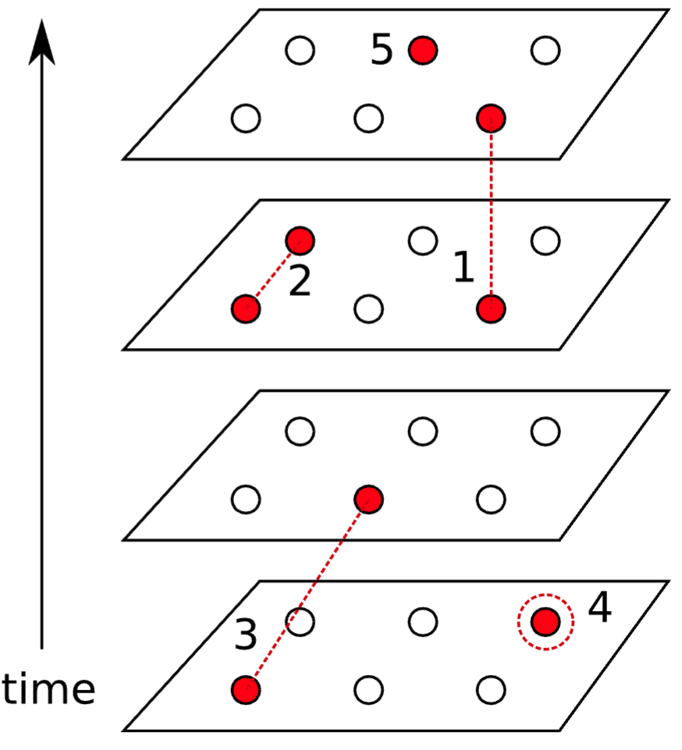
Realistic quantum noise (3/4)
Decoder: a lookup table
Types of flips
(1) Measurement error
(2),(3) Paired flips indicating a single qubit error on data qubit
(4) A single flip indicating one data-qubit error
(5) Undetermined flip
Each circle represents a syndrome measurement

Slide 33
Realistic quantum noise (4/4)
Comparison of pseudothresholds under exact noise models and Pauli-twirl
the pseudothreshold under the exact noise models is higher
Pauli-twirl approximation
is a conservative lower bound on the performance of QECC
can be efficiently computed.

Slide 34
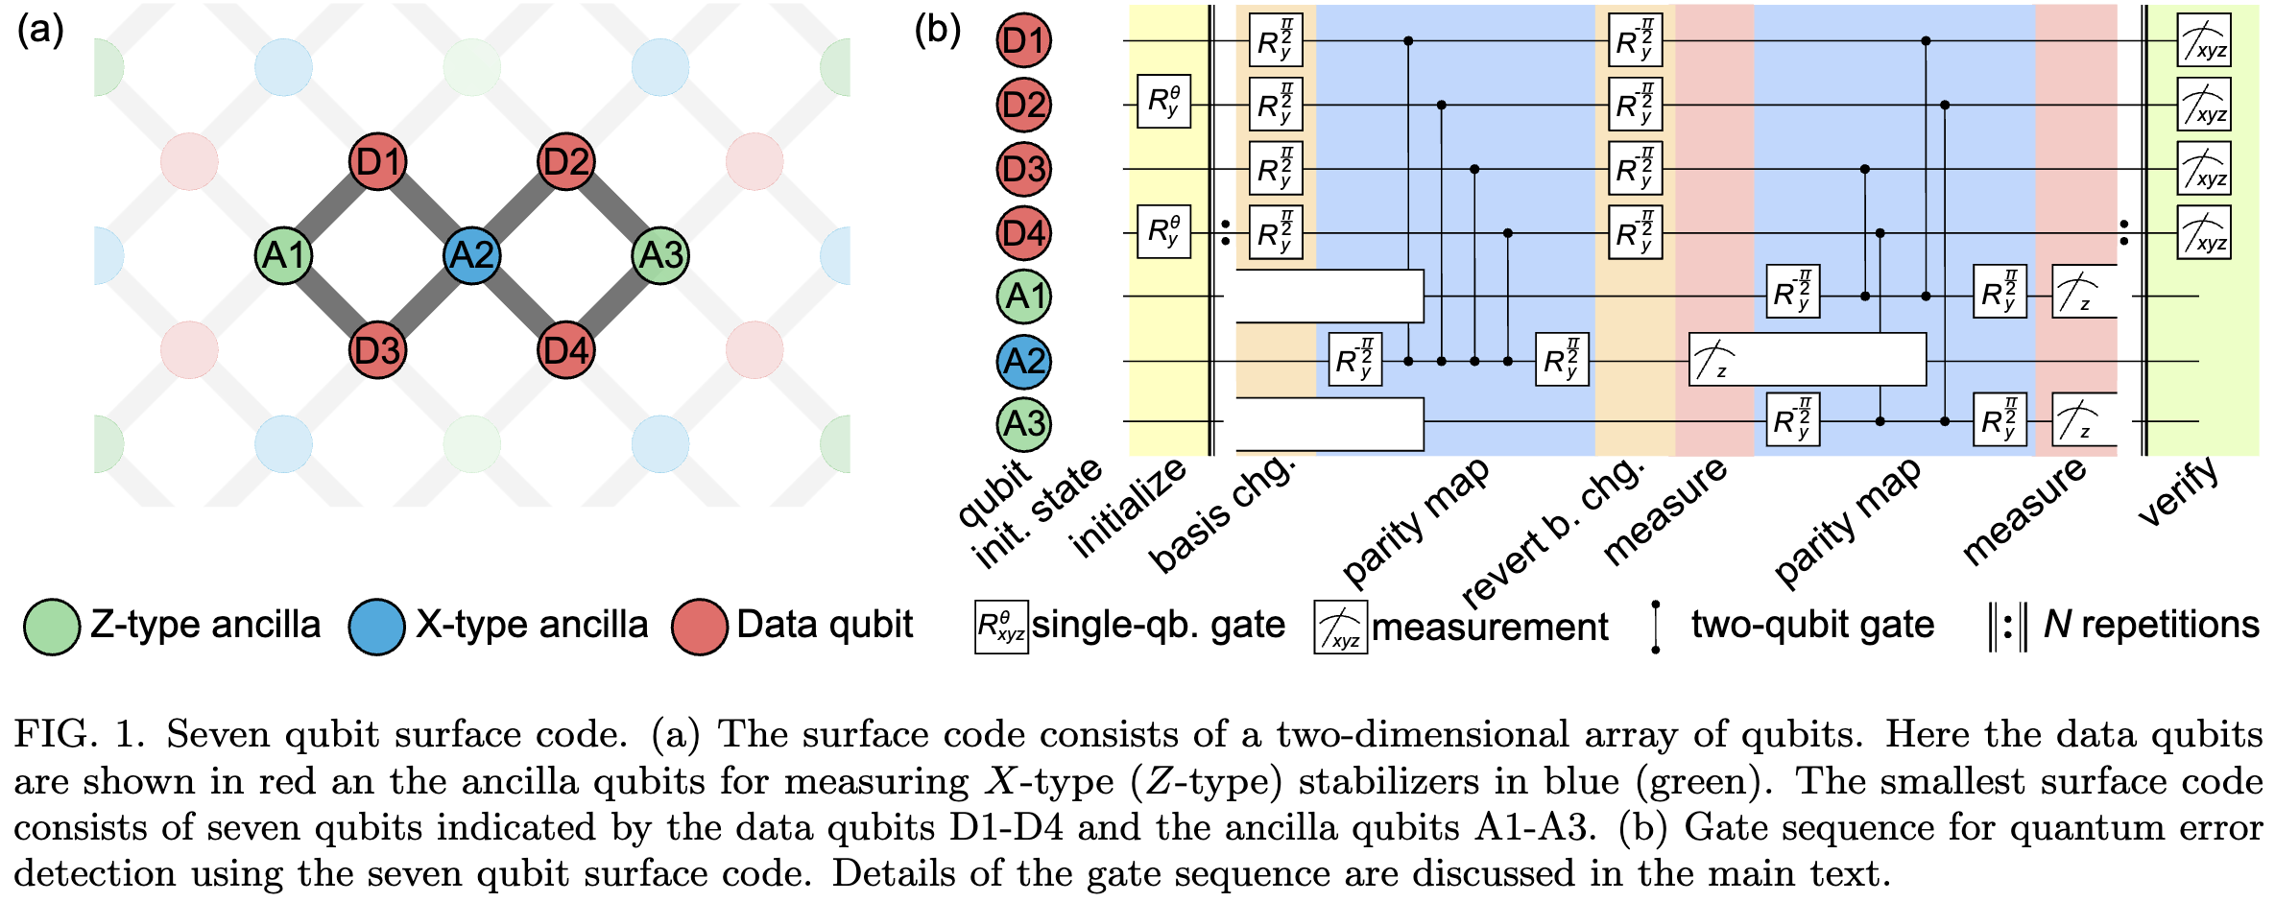
7-qubit repeated QED (1/2)
“Repeated quantum error detection in a surface code”
https://arxiv.org/abs/1912.09410
Implement a surface code capable of repeatedly detecting single errors
Essential for large-scale fault-tolerant quantum computing systems
Implement the smallest viable instance of a surface code
4 data qubits
3 ancilla qubits

Slide 35
7-qubit repeated QED (2/2)
The logical quantum state could be preserved with a lifetime and coherence time longer than any of the constituent qubits when no errors were detected
For both operators, the logical error probabilities per stabilizer measurement cycle are lower than the physical error rates of the qubits involved
 | Lifetime (10^(-6) s) | Coherence time (10^(-6) s)
Logical | 62.5 ± 9.4 | 72.5 ± 32.9
Physical | 16.8 | 21.5
Operator | Logical error probabilities per stabilizer measurement cycle
X_{L} | 3.1 ± 0.45%
Z_{L} | 2.6 ± 1.3%

